Slide 1
Process Models

Slide 2
What is ‘Software Process Model’?
A software process model is a standardised format for
  planning
  organising, and
  running
a development project.

Slide 3
Different families of models
Prescriptive Agile
Goal: Higher Quality Software
Philosophy:
Bring order to chaos
Provide repeatability/consistency
Provide ability to control
Provide ability to coordinate teams
Goal: Higher Quality Software
Philosophy:
Individuals and interaction over process and tools
Working software over large documentation
Customer collaboration over contract negotiation
Responding to change over following a plan

Slide 4
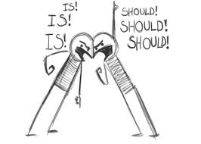
Prescriptive Models
Prescriptive process models advocate an orderly approach to software engineering
That leads to a few questions …
If prescriptive process models strive for structure and order,
  are they inappropriate for a software world that thrives on change?
  can we replace them with something less structured?

Slide 5
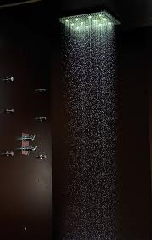

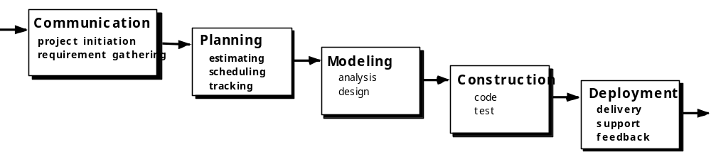

The Waterfall Model
Use when:
Requirements are stable and well-understood, very
short timeline (maintenance fixes)
Notes:
CHALLENGES: Final product only available at the end
Things always change.

Slide 6
Why was the waterfall model designed?
Invented in 1970
It is frequently true that time spent at the beginning of the product lifecycle cuts down on the work in later stages
  How much time does maintenance consume?
The biggest lesson learned is that waterfall models
  Generally don’t work
  Because it’s unrealistic to not have change

Slide 7

The V-Model
Same as Waterfall, diagram used to emphasize types of testing are linked to different phases in the model
Requirements are stable and well-understood

Slide 8
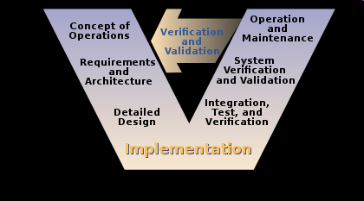
The V model
Focuses on verification and validation

Slide 9
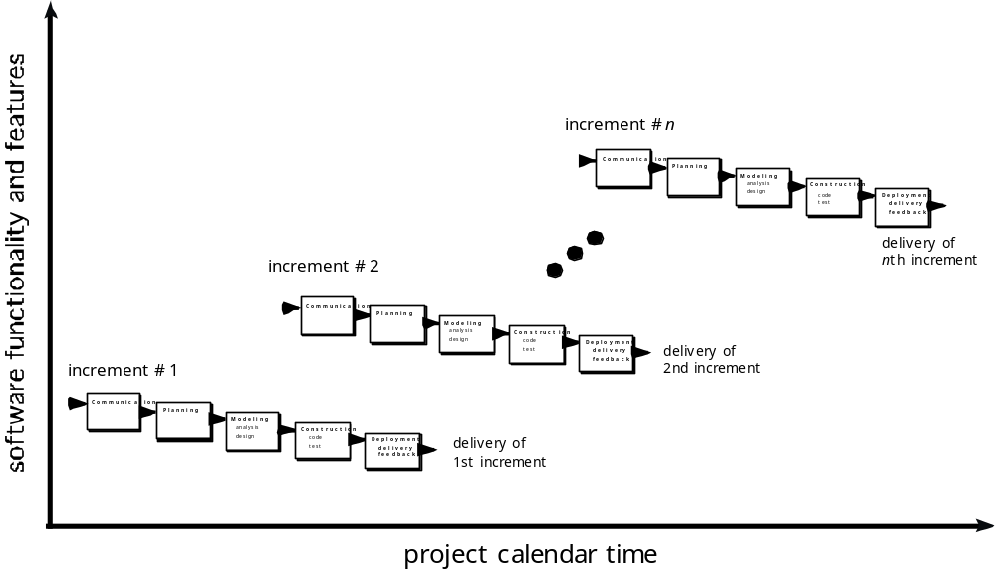
The Incremental Model
Notes:
Delivers software in usable “increments” each containing a working version of the system, just fewer features.
Helps get software to users faster
Provides an evaluation and re-planning ability to the team
May complete an initial functionality to get buy-in/funding for later increments

Slide 10
The Incremental Model
Requires: Operational product that provides some value to users at each increment.
Advantages
Helps users get software faster
Provides ability for the team to evaluate and
replan
May complete an initial functionality to get buy-
in or funding for later increments
Disadvantages
May not be good for very risky systems
Full working systems may require long increments
Notes:
Delivers software in usable “increments” each containing a working version of the system, just fewer features.
Helps get software to users faster
Provides an evaluation and re-planning ability to the team
May complete an initial functionality to get buy-in/funding for later increments

Slide 11
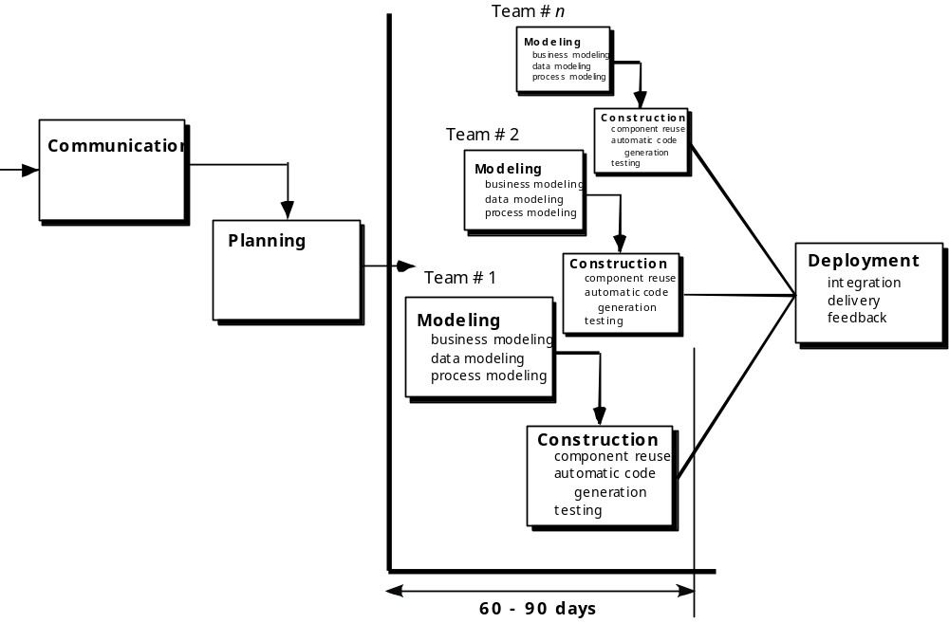
The RAD Model
Notes:
Used when requirements are also well-understood
Very fast cycles (60-90 days)
Emphasizes use of existing components/automatic code generation
Challenges:
Lots of staff needed to form RAD teams
Must have component based software
Developers and Customers must be willing to make quick decisions

Slide 12
The RAD Model
RAD = Rapid Application Development
Requires: very well understood requirements.
Very fast cycles (60-90 days) to create a lot of functionality
Emphasizes use of existing components/ automatic code generation
Challenges:
Large staff needed to form RAD teams
Must have modularizable based software
Developers and Customers must be willing to make quick decisions
Time-consuming overall system tuning is difficult

Slide 13

Evolutionary Models: Prototyping
Used when partial system can be delivered, then evolved into full system
Prototyping is a tool that can be used during any process
Used when customer only has a vague idea of what they want
Plan to either throw-away or evolve into real product -- there will be pressure at the end to evolve into the real product
Quick
plan
communication
Modeling
Quick design
Deployment
delivery &
feedback
Construction
of prototype
Coming up: Evolutionary Models: The Spiral
Notes:
Try to use throw-away prototyping -- hard to do!

Slide 14
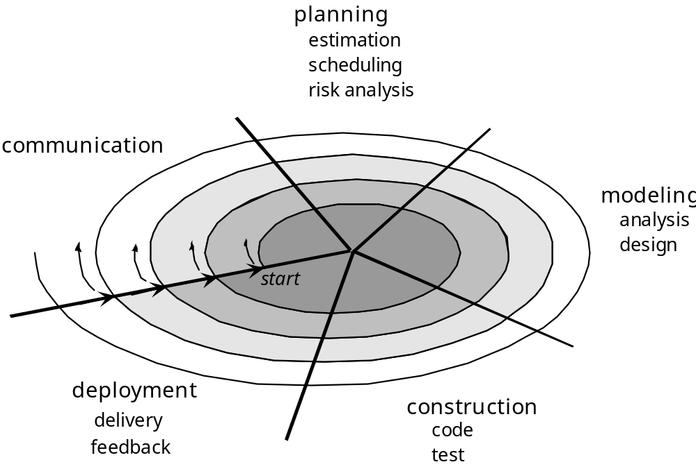
Evolutionary Models: The Spiral
Complete highest risk items first
Used to mitigate risk on risk-intensive projects
Every spiral revises cost/budget/schedule/etc…
Coming up: Still Other Process Models
Notes:
Early spirals may just generate documentation/paper prototypes
Later spirals then generate prototypes in software
Then increasingly fuller versions of the software (not necessarily a working useful version of the software)

Slide 15
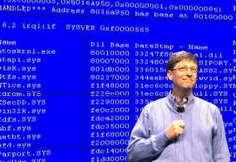
Can you guess which company uses the spiral model?

Slide 16
Other Process Models
Component based development—the process to apply when reuse is a development objective
Formal methods—emphasizes the mathematical specification of requirements
AOSD (Aspect-oriented software development ) —provides a process and methodological approach for defining, specifying, designing, and constructing aspects
Unified Process — a “use-case driven, architecture-centric, iterative and incremental” software process closely aligned with the Unified Modeling Language (UML)
Coming up: The Unified Process (UP)
Notes:
Formal Methods - safety critical software like avionics, medical devices
Aspects - cross-cutting concerns (like logging, security, etc…). AspectJ

Slide 17

The Unified Process (UP)
Coming up: UP Phases
Notes:
･Inception - do you and the Customer have a shared understanding of the system?
--- Use cases, initial use cases, basic architecture
･Elaboration - do you have an architecture to be able to build the system?
--- Detailed use cases, 5 perspectives - use cases, analysis, design, implementation, deployment model
･Construction - are you developing product?
･Transition - are you trying to get the Customer to take ownership of the system?
--- beta-testing, system testing, final documentation (user manuals, help etc…)

Slide 18
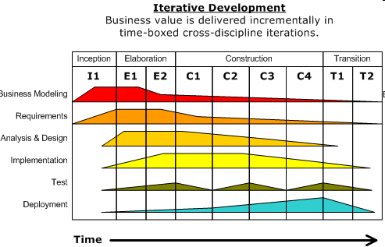
The Unified Process
What is it?
  Phases: inception, elaboration, construction, transition
  The phases are divided up into time-boxes (iterations)
  Each of these iterations results in some deliverable increment

Slide 19
The Unified Process
Inception - do you and the Customer have a shared understanding of the system?
  Use cases, initial use cases, basic architecture
Elaboration - do you have an architecture to be able to build the system?
  Detailed use cases, 5 perspectives - use cases, analysis, design, implementation, deployment model
Construction - are you developing product?
Transition - are you trying to get the Customer to take ownership of the system?
  beta-testing, system testing, final documentation (user manuals, help etc…)

Slide 20
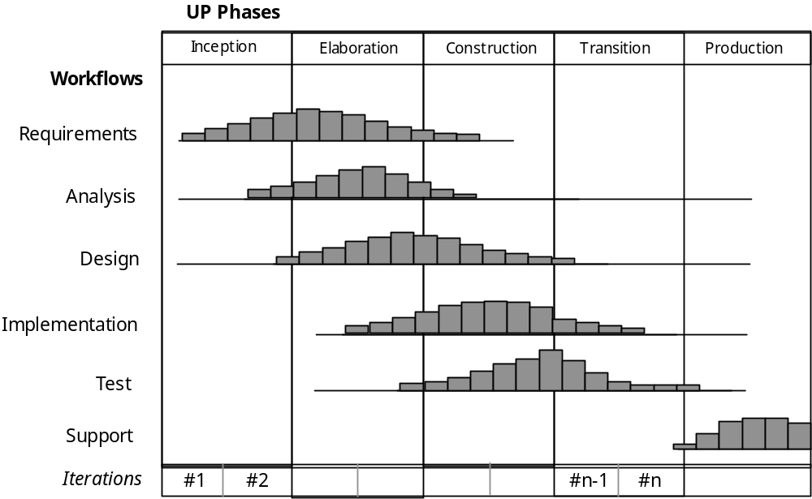
UP Phases
Coming up: UP Work Products

Slide 21
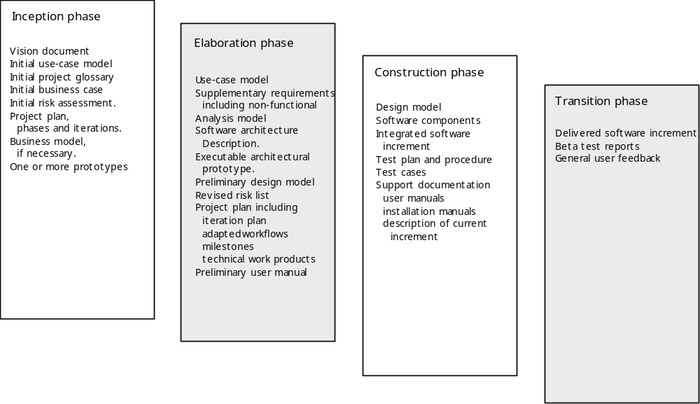
UP Work Products

Slide 22
Pick a model
Developing software to automatically drive racecars through a track without crashing. This has never been attempted before under software control. The requirements are stable.
Waterfall, Incremental, Spiral, RAD?

Slide 23
NEXT : AGILE MODELS
CASE STUDIES : IN LAB

